Slide 1
MQTT Broker

Slide 2
MQTT BROKER
MQTT: The Standard for IoT Messaging
MQTT is an OASIS standard messaging protocol for the Internet of Things (IoT). It is designed as an extremely lightweight publish/subscribe messaging transport that is ideal for connecting remote devices with a small code footprint and minimal network bandwidth. MQTT today is used in a wide variety of industries, such as automotive, manufacturing, telecommunications, oil and gas, etc.

Slide 3
Mqtt Broker - Security
The Mqtt broker protects itself with basic authentication in a secure network, it also communicates securely with the TLS certificate in order to encrypt the communications.
If requested, OAuth Access Tokens or JSON Web Tokens can be added.
Ex: mosquitto_sub -h localhost –p 1883 --cafile ca.crt -t 'platooning/broadcast/platooningId’ –i leadvehicleId -v -u test -P test

Slide 4
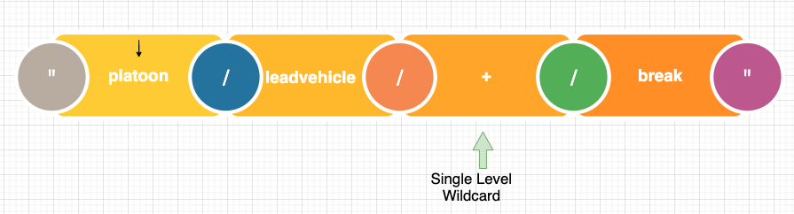
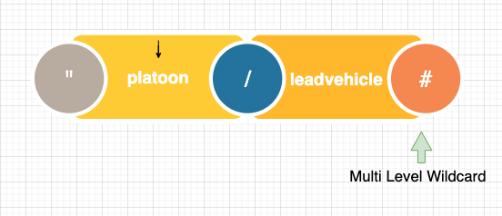
Mqtt broker - Topic and Wildcard
Topic and Wildcards
Messages are addressed through the use of topics
Topics are sparated by a «/» allowing topics to be grouped in a tree structure
How Mqtt Broker design the topics
How Mqtt Broker design the topics is important to allow efficient use of wildcard matching
There are two wildcard characters «#» , «+» and level separed «/»
«#» is multi-level covers an arbitrary number of topic levels.
«+» is single level replaces one topic level

Slide 5
Creating and Joining New Platoon
Connected all vehicles in the platoon, lead and followings can be communicated each other using specific topics
Lead vehicle can create new platoon and publish its maneuverers to other following vehicles using mqtt broker
Following vehicle can be subscribed as its specific topic for to join communicating the mqtt broker
Following vehicle has to send the request for joining the platoon
Lead vehicle can accept the joining the platoon request

Slide 6
Messaging to MQTT broker
https://www.notion.so/kursatarslan/Ford-Otosan-17d879a3d1fa4cf089d2b319d18b94d6#043c0d2c694c43f5abad04ea5359cc23

Slide 7
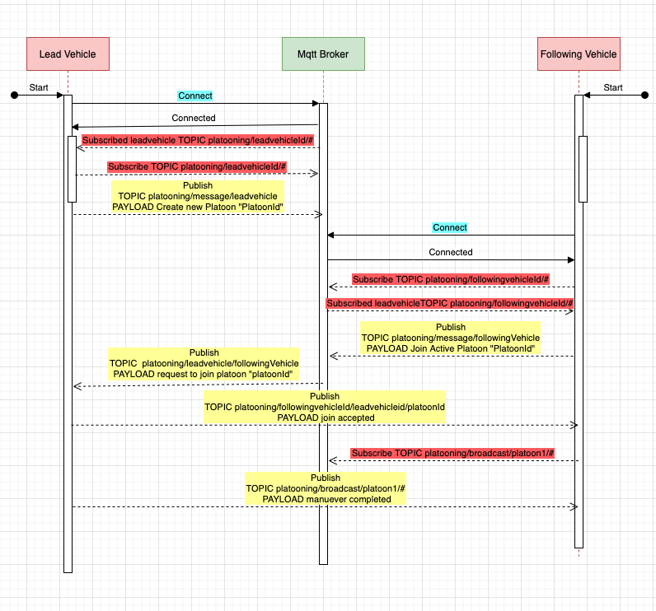
Communication sequence diagram
Topic platooning/message/#
Just Mqtt Broker listen and response
Topic platooning/leadVehicleId/#
Lead vehicle subscribe with the topic
Topic platooning/followingVehicleId/#
Following vehicle subscribe with the topic
Topic platooning/broadcast/platoonId/#
Lead vehicle publishes its coordinate and its maneuverers and all following vehicle in the platoon listen this topic they subscribe

Slide 8
Thank you !

